Slide 1



School of Computing and Information Technology, Eastern International University (EIU) - Vietnam

Slide 2
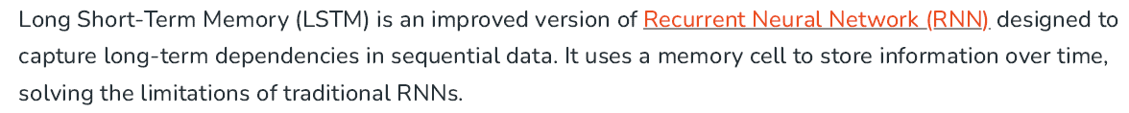

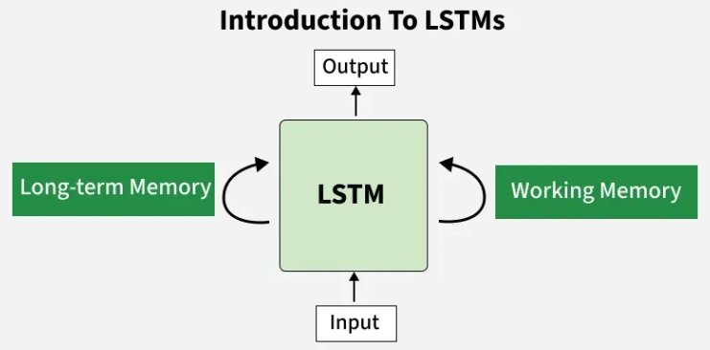
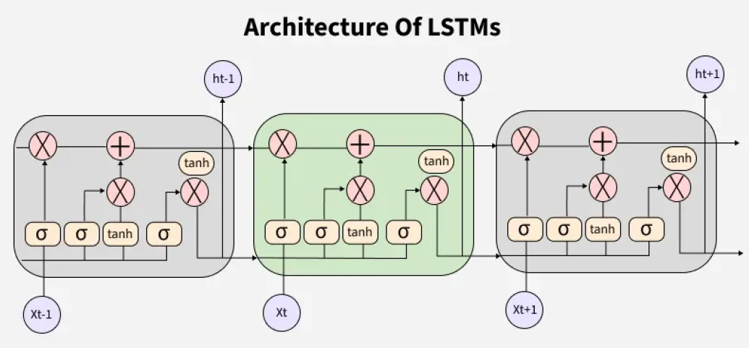

Slide 3
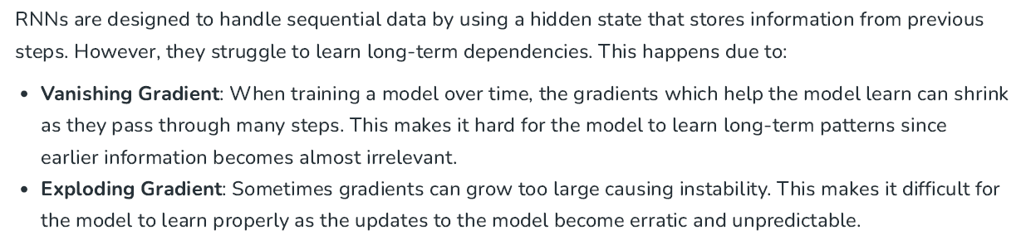
School of Computing and Information Technology, Eastern International University (EIU) - Vietnam

Slide 4

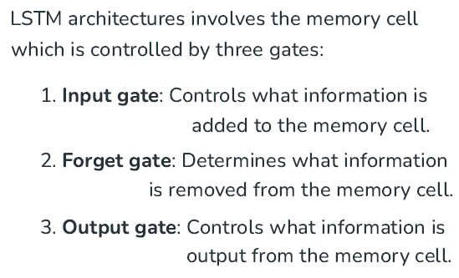
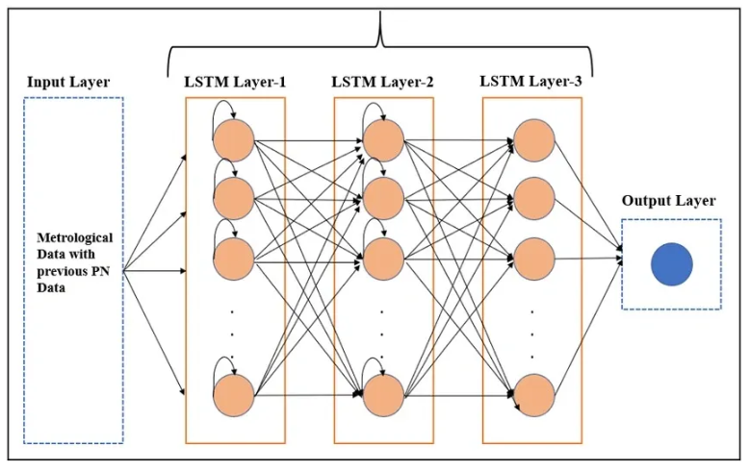
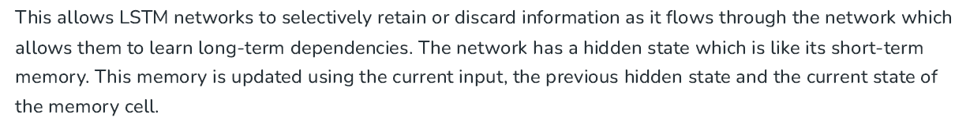
School of Computing and Information Technology, Eastern International University (EIU) - Vietnam

Slide 5

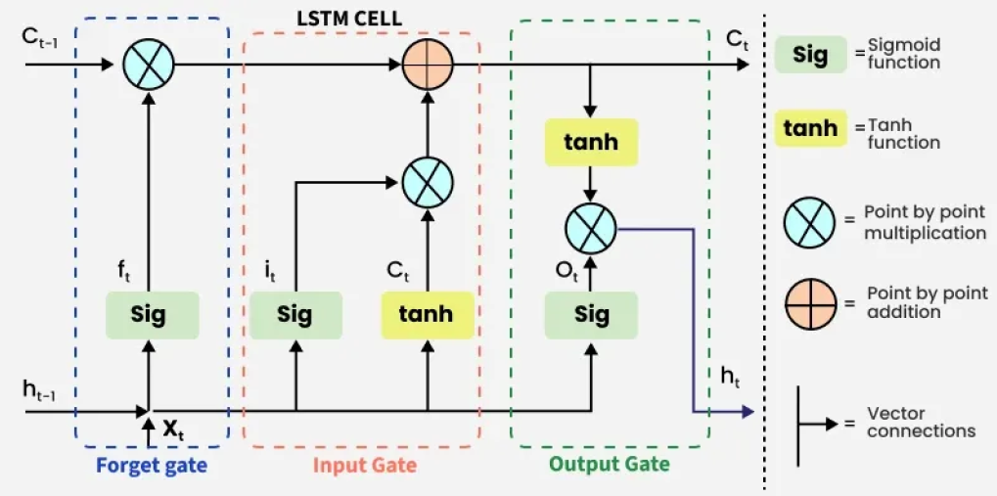

Slide 6

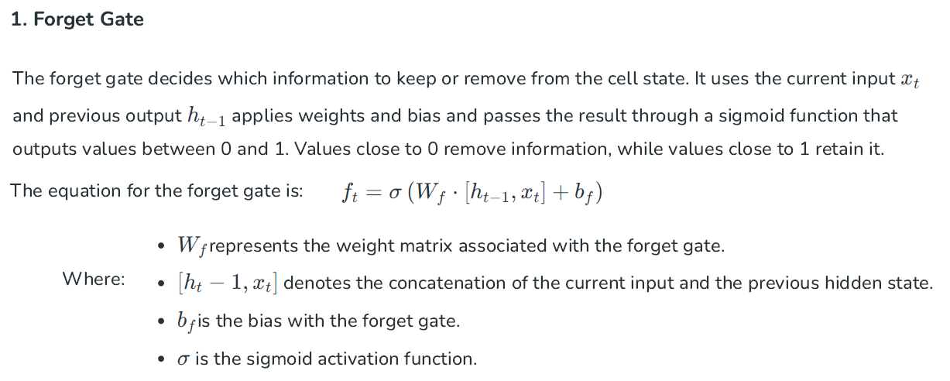
School of Computing and Information Technology, Eastern International University (EIU) - Vietnam

Slide 7
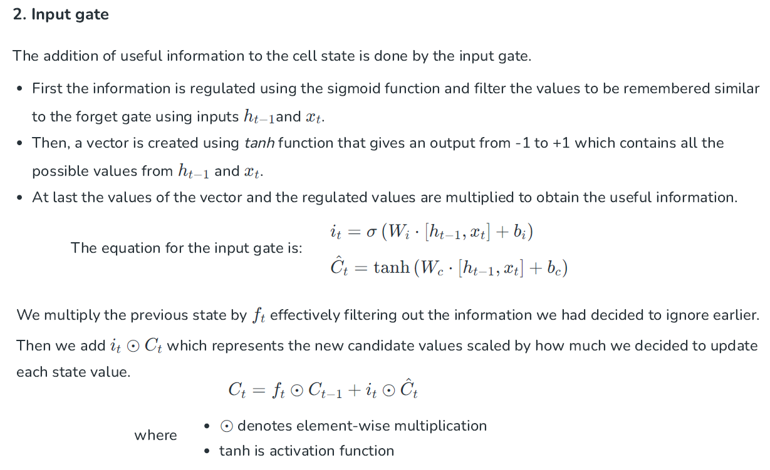

Slide 8
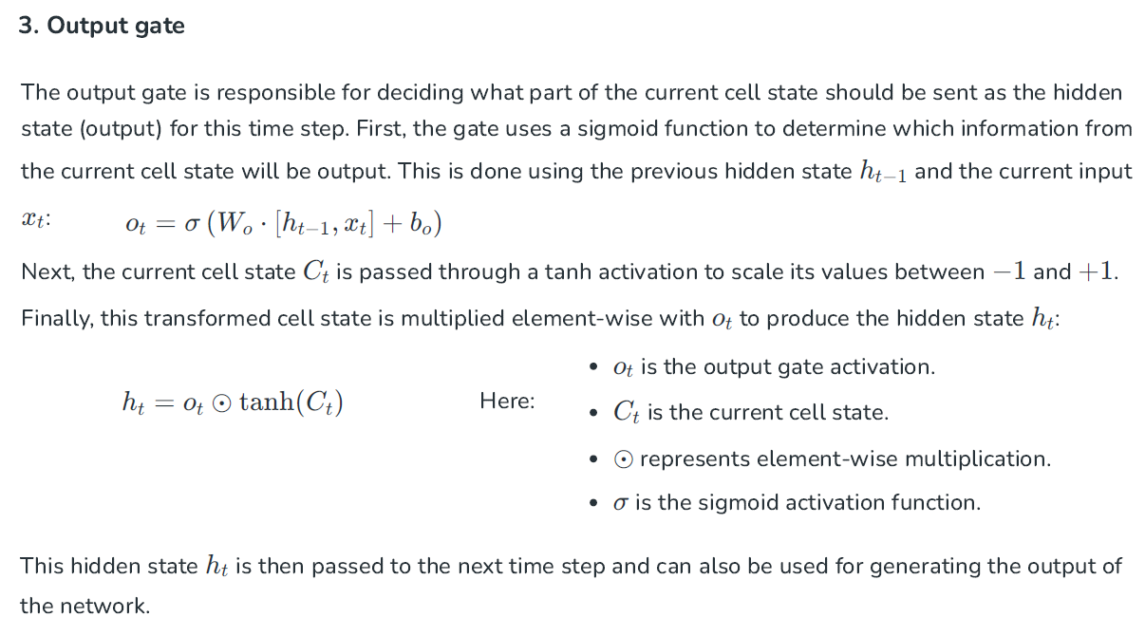

Slide 9

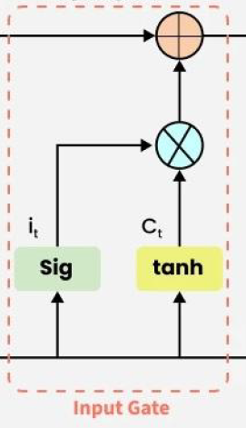




School of Computing and Information Technology, Eastern International University (EIU) - Vietnam

Slide 10

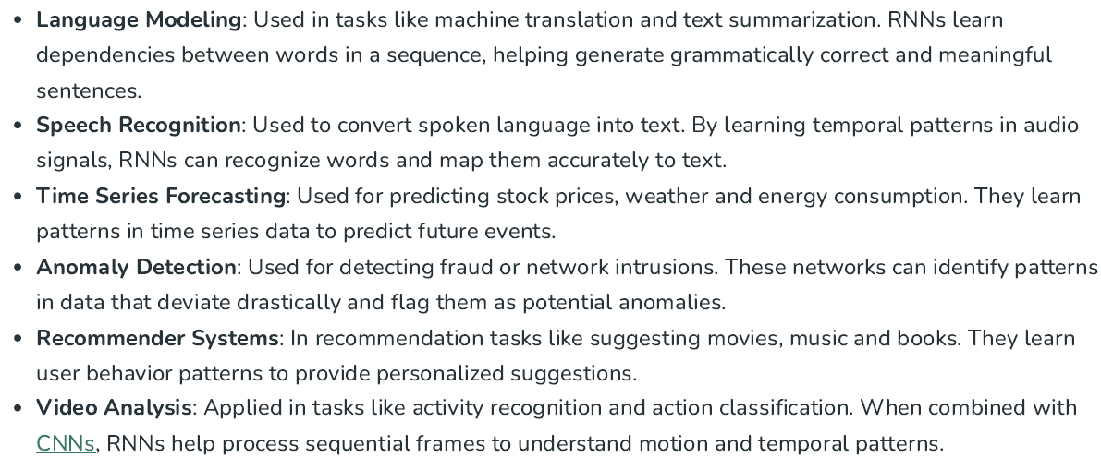
School of Computing and Information Technology, Eastern International University (EIU) - Vietnam

